Slide 1

Deploy Static Website to AWS S3 with HTTPS using CloudFront
2000031605
T.Mani Chandana
Sec-14

Slide 2
Steps For Deploying
1)Static Website Hosting
2)Permissions
3)SSl Certificate
4)Create SSL Certificate
5)Request A certificate
6)DNS Validation
7)Create a Cloudfront Distribution
8)Redirect Http to Https
9)Create Distribution

Slide 3
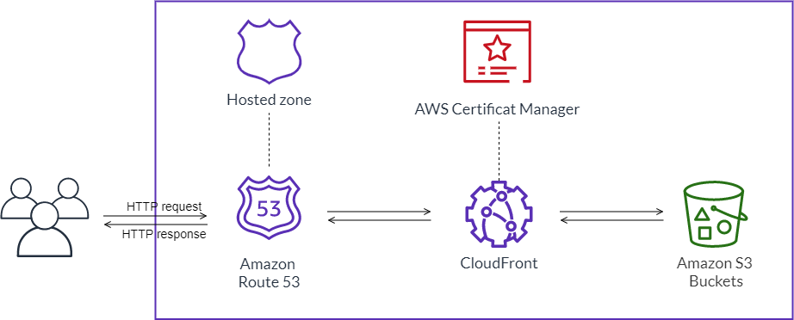

Slide 4
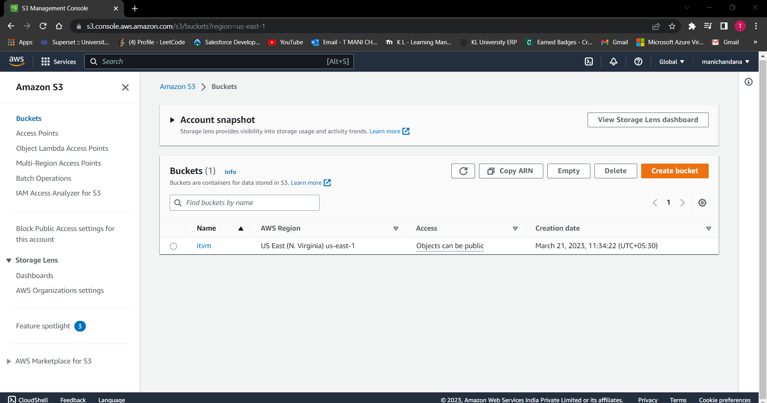

Slide 6
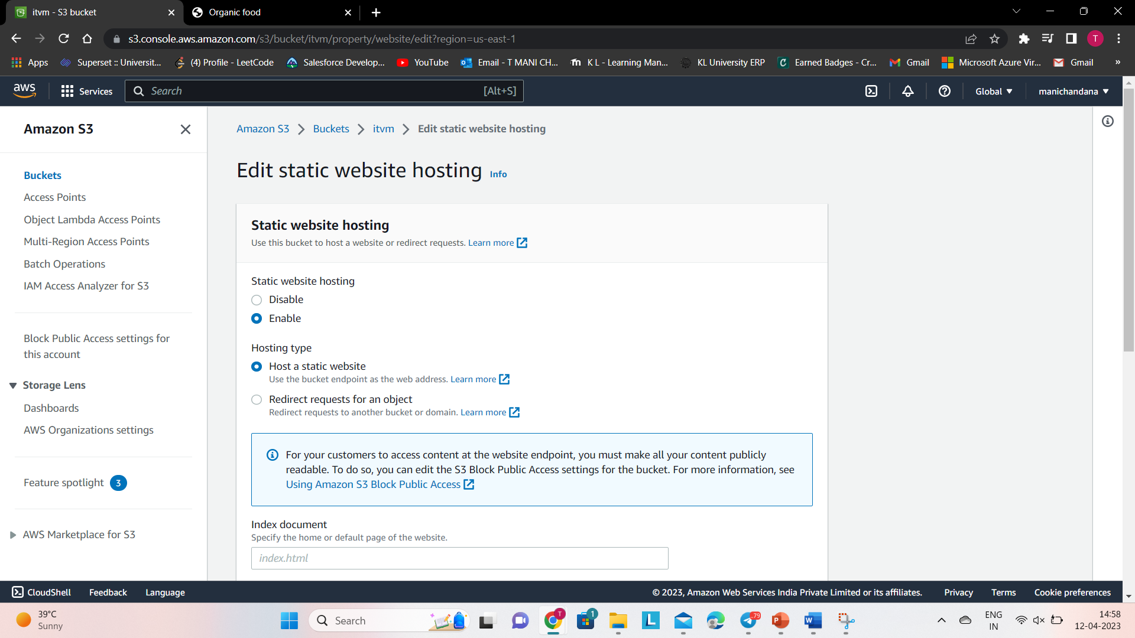

Slide 7
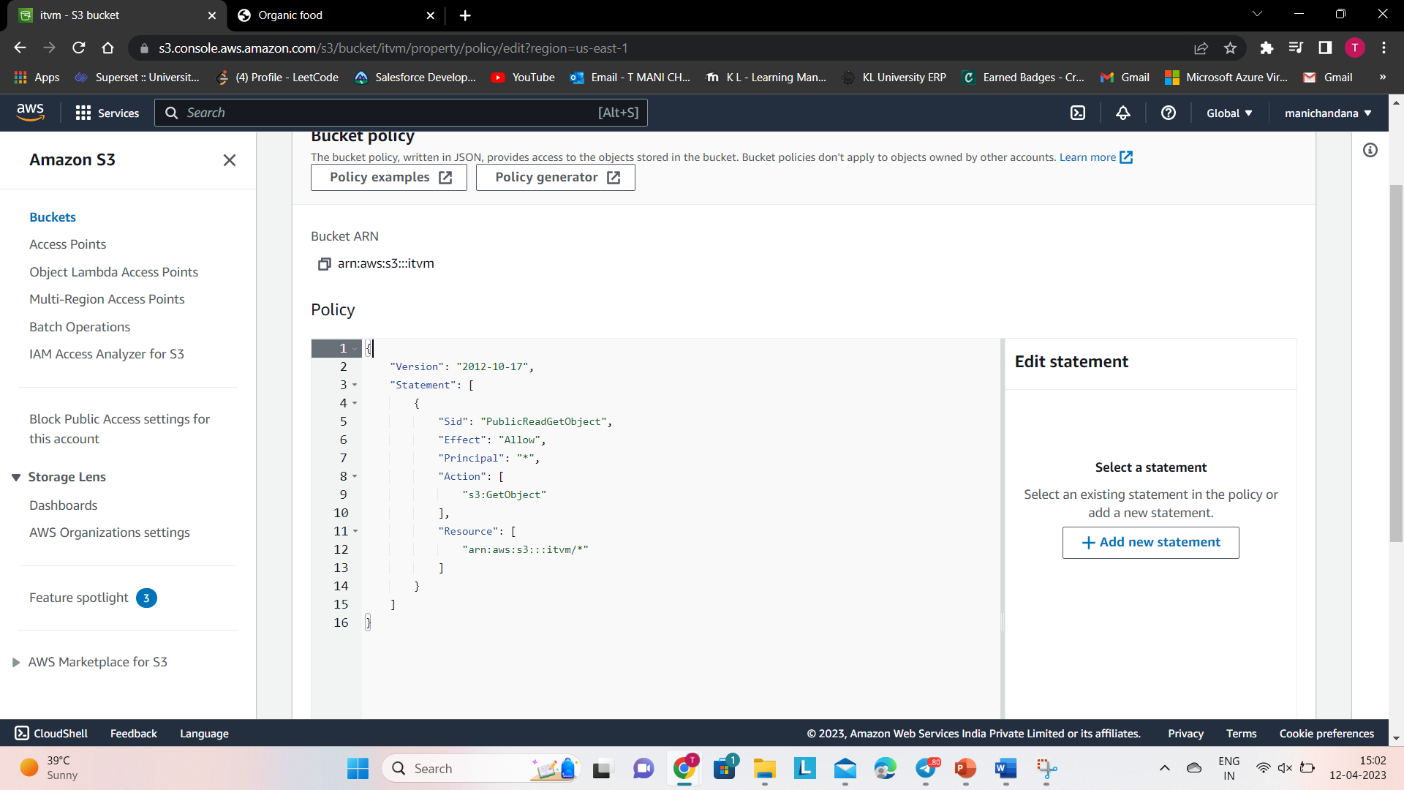

Slide 8
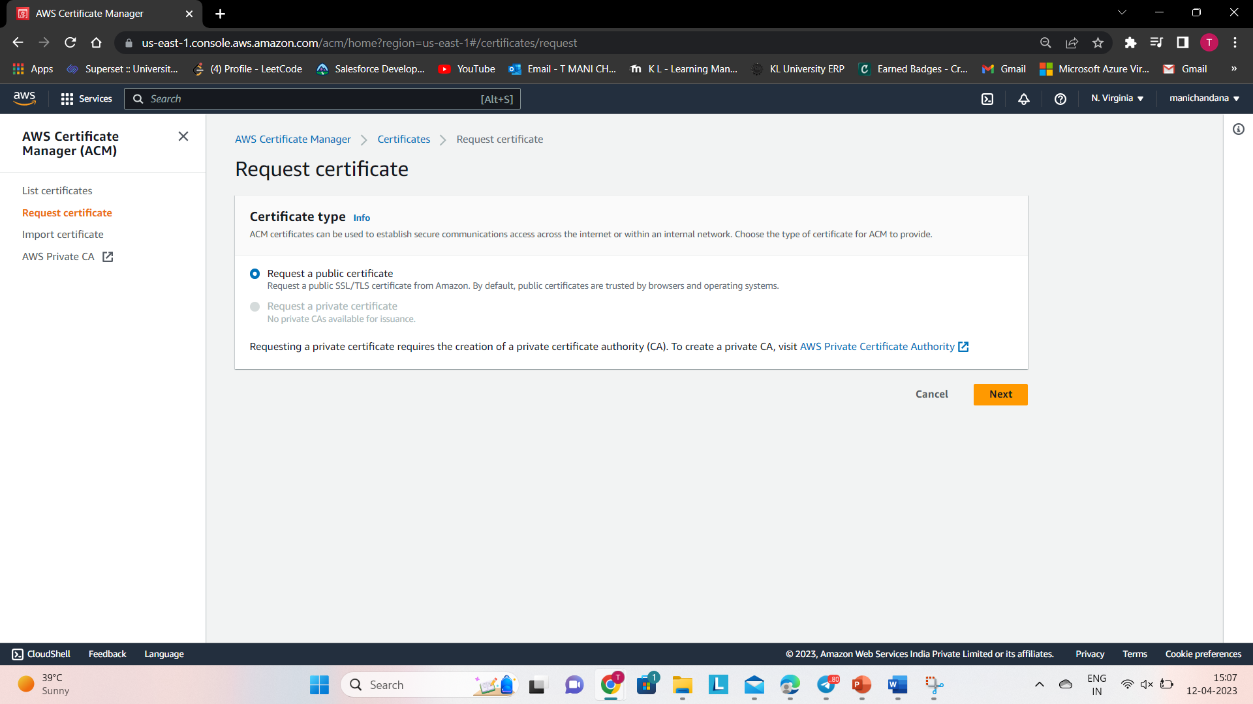

Slide 9
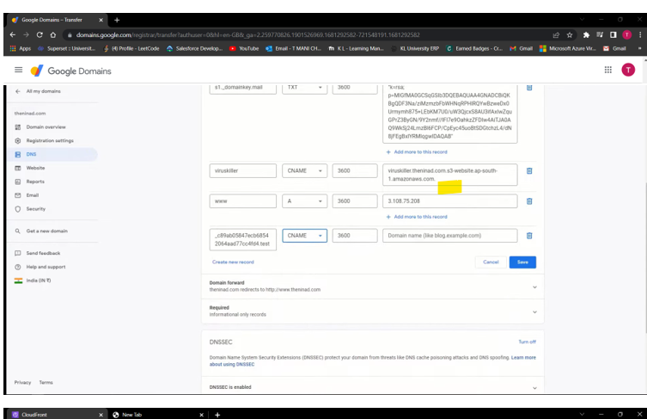

Slide 10
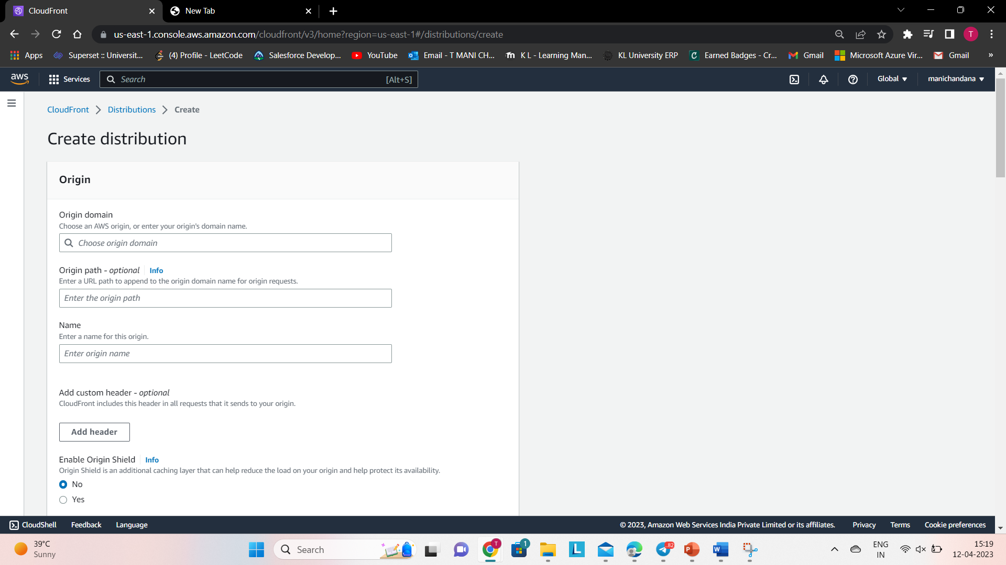

Slide 11
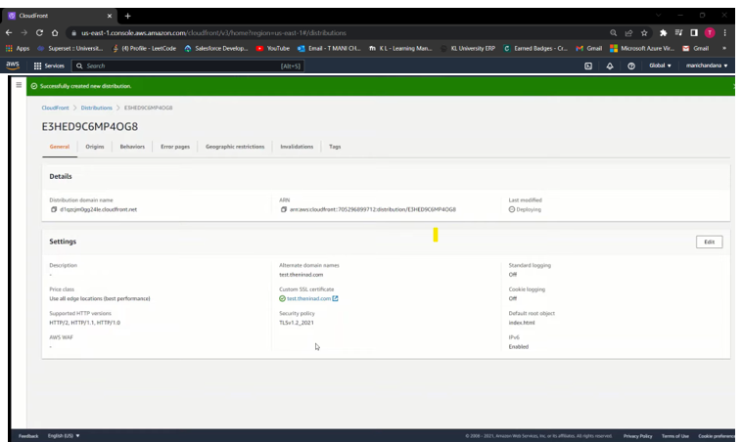

Slide 12


